Slide 1
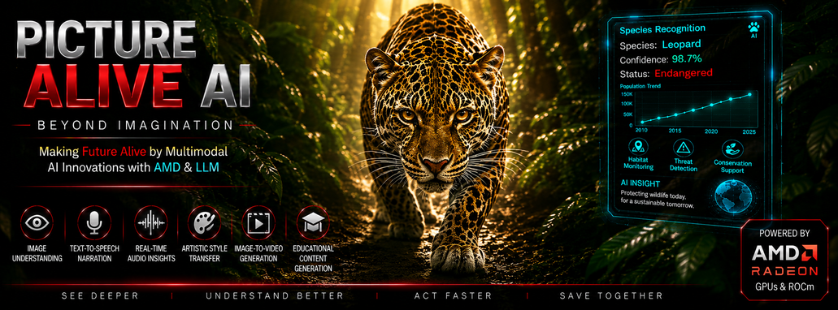
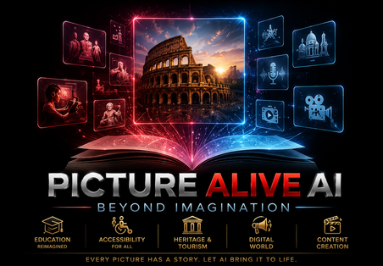
PICTURE ALIVE AI
Beyond Imagination
Project Profile Document
WHAT'S INSIDE | Project Background, Description & Inspiration Target Users & Application Scenarios System Architecture Model & Algorithm Introduction Adaptation for AMD Radeon GPU / ROCm
2026 AMD AI DevMaster Radeon GPU Hackathon
July 14 - August 6, 2026 -- Track 1: Development of Multimodal Content Creation Tools
Team: Poppenspel Advies AI
GITHUB - https://github.com/Poppenspel-Advies/picture-alive-ai
WIKI - https://github.com/Poppenspel-Advies/picture-alive-ai/wiki
Picture Alive AI -- Project Profile Document

Slide 2
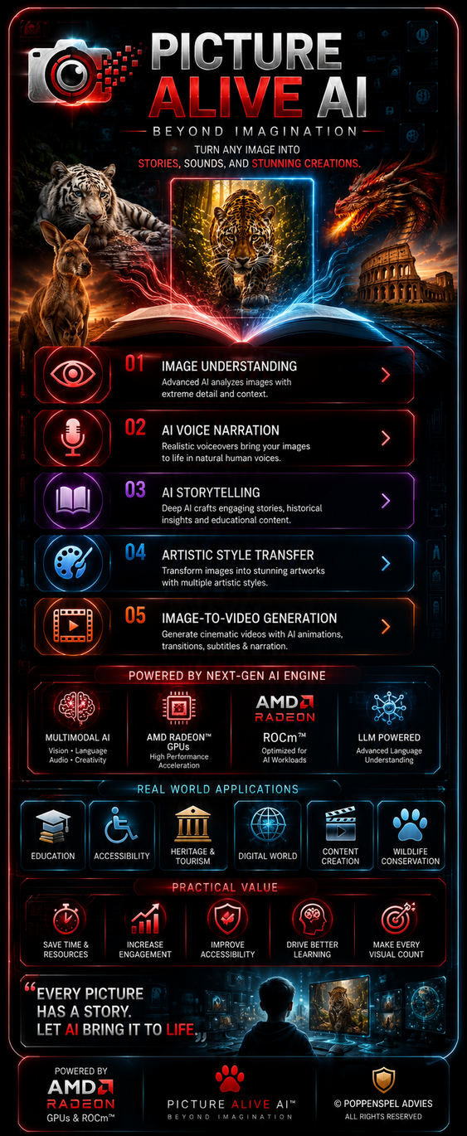
Project Background, Description & Inspiration
Picture Alive AI was inspired by a simple but powerful vision: every image has a story waiting to be discovered, understood, and shared. Across education, accessibility, cultural heritage, business, and digital media, billions of images remain static, limiting their ability to educate, inspire, and communicate. While advances in artificial intelligence have transformed text, speech, and visual understanding, these capabilities are often fragmented across multiple tools. Picture Alive AI addresses this challenge by unifying multimodal AI into a single intelligent platform that transforms visual content into immersive, meaningful experiences.
Picture Alive AI enables users to upload photographs, paintings, historical artifacts, educational diagrams, scientific illustrations, and everyday images, then automatically generates contextual explanations, natural voice narration, educational insights, AI-powered storytelling, artistic style transformations, and short AI-generated videos. By integrating advanced vision-language models, text-to-speech synthesis, and image-to-video generation, the platform makes visual information more accessible, engaging, and impactful for diverse audiences.
Accelerated by AMD Radeon GPUs and the ROCm software stack, Picture Alive AI delivers high-performance multimodal inference capable of supporting real-time, scalable AI experiences. The platform is designed to empower educators, students, museums, tourism organizations, content creators, marketers, businesses, and visually impaired communities through a single, intuitive solution.
Our inspiration extends beyond technology -- we envision a future where every picture can educate, every historical artifact can tell its story, every creative idea can become multimedia content, and every individual, regardless of ability, can access visual information in meaningful ways. Picture Alive AI represents a new generation of multimodal AI innovation.
Picture Alive AI -- Project Profile Document

Slide 3
2. Target Users & Application Scenarios
Target Users
Educational institutions, teachers, students, and e-learning platforms.
Museums, libraries, cultural heritage organizations, and tourism boards.
Accessibility organizations and visually impaired communities
Digital creators, photographers, filmmakers, designers, and influencers.
Marketing agencies, advertising firms, and enterprise businesses
Wildlife researchers, conservation groups, parks, and zoological institutions.
Healthcare, scientific research, engineering, manufacturing, and government
Application Scenarios
Convert educational images, scientific diagrams, and historical artifacts into narrated lessons and immersive learning experiences.
Enhance accessibility by generating intelligent image descriptions and natural voice guidance for visually impaired users.
Bring museums, monuments, and cultural heritage sites to life through AI-powered storytelling and multilingual digital tours.
Transform product images, advertisements, and creative assets into engaging multimedia content for the Digital World.
Support wildlife conservation by identifying species, narrating ecological insights, monitoring habitats, documenting endangered animals such as kangaroos, white tigers, leopards, and birds, and generating educational awareness content.
Enable enterprises and content creators to rapidly produce AI-generated videos, voiceovers, marketing campaigns, and digital experiences from a single image.
By combining vision, language, speech, and creative AI into one unified platform, Picture Alive AI delivers measurable value across education, accessibility, conservation, business, and digital transformation while advancing the future of multimodal artificial intelligence.
Picture Alive AI -- Project Profile Document

Slide 4
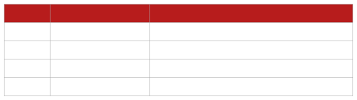
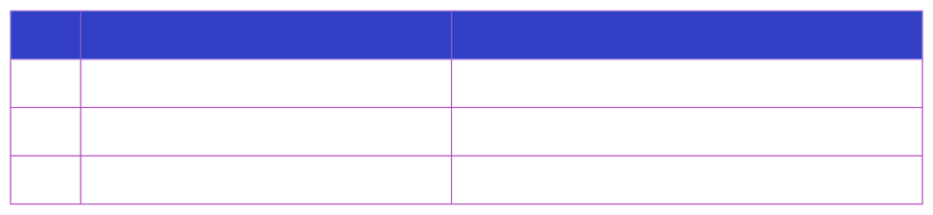
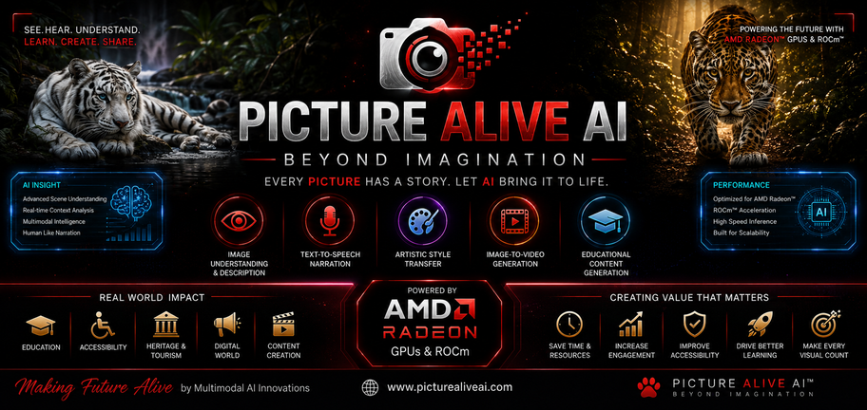
3. System Architecture
Picture Alive AI implements a modular, cloud-native architecture deployed on AMD Radeon GPU environment driven by the ROCm software stack. The system processes user image uploads through a defined pipeline spanning four layers:
LAYER
COMPONENT
TECHNOLOGY
1. Frontend
Web Design
ComfyUI, React + Vite + Tailwind CSS
2. Backend
FastAPI server
Python 3.11, uvicorn, httpx
3. AI Models
Gemma 4 + Kokoro-82M
Multimodal LLM + TTS synthesis
4. Infra
Cloud GPU + CI/CD
AMD Radeon, Docker, GitHub Actions
Data Flow: User upload image
Frontend validation → Backend FastAPI → Gemma 4 vision analysis SSE stream to frontend. Optional (Audio Guide): text → Kokoro-82M
→
→
Gemma 4 text generation
→
TTS
→
WAV download.
API Endpoints
Method Endpoint
Description
POST
/api/modes/{mode}/analyze
Upload image (max 10 MB) -> Gemma 4 SSE output
POST
/api/audio/generate?text=
Text -> Kokoro-82M WAV (24 kHz) download
GET
/health
JSON health status
The architecture is intentionally stateless -- image bytes are validated and processed inline, never persisted to disk. Requests validated for size, MIME type (JPEG/PNG), and mode name. Errors return appropriate HTTP status codes.
Picture Alive AI -- Project Profile Document

Slide 5
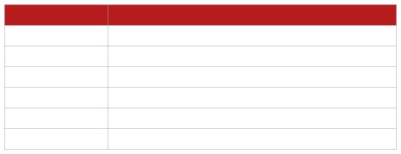
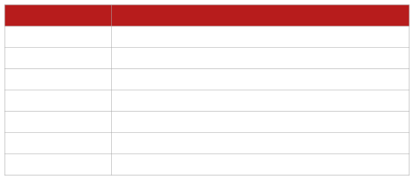
4. Model & Algorithm Introduction
Gemma 4 -- Vision + Text (Multimodal LLM)
Property Model Developer Parameters Input Output License
Value
gemma-4-26b-a4b-it
Google DeepMind (Google AI Studio API)
26B total / ~4B active (Mixture-of-Experts sparse) JPEG/PNG base64 + natural-language prompt Natural language text
Free tier for hackathon use
Gemma 4 is employed via a two-stage pipeline: Stage 1 -- image + domain prompt (e.g. descriptive, story) -> Gemma returns visual analysis. Stage 2 -- analysis + text generation prompt -> Gemma produces the final text which streams to frontend via SSE.
Kokoro-82M -- Text-to-Speech Synthesis
Property Model Parameters License Input Output Architecture Inference
Value
Kokoro-82M
82 million
Apache 2.0 -- free, open source, no usage limits
Plain text
24 kHz WAV waveform
Curated phoneme transformer: text -> phonemes -> mel -> audio Local GPU/CPU, PyPI package: kokoro 0.9.4+
License
Kokoro-82M is a compact self-contained TTS model built around a curated phoneme transformer. For Picture Alive AI, it generates accessible audio narrations and spoken story scenes -- entirely free and with zero usage limits.
Picture Alive AI -- Project Profile Document

Slide 6
5. Adaptation for AMD Radeon GPU / ROCm
Picture Alive AI is built for AMD Radeon hardware and accelerated through the ROCm software stack. The entire backend inference path takes advantage of GPU acceleration for compute-intensive audio synthesis.
Kokoro-82M on AMD Radeon GPU
• • • • •
Audio pipeline runs on-device on AMD Radeon GPU via ROCm 6.0+ & PyTorch ROCm backend. Curated-transformers architecture works natively on AMD CDNA/RDNA GPUs.
Install ROCm, then: pip install torch --index-url https://download.pytorch.org/whl/rocm6.0
Runtime: torch.cuda.is_available() returns True, KPipeline auto-routes to GPU.
Less than 1s per sentence; zero NVIDIA or CUDA dependency.
Gemma 4 via API
•
Gemma accesses Google AI Studio API on cloud infrastructure; optionally AMD-accelerated nodes.
4B active per forward pass -- suitable for both cloud and local ROCm deployment.
Backend calls inference.googleapis.com/v1/models/gemma-4 with API key.
• •
Deployment on GPU-Enabled Containers
• • •
Deployed in Radeon Cloud GPU via Public URL Deployment for Public Web URL.
Command: python -m uvicorn main:app --host 0.0.0.0 --port 8000 (0=t bound to all interfaces), for Backend server. Graceful CPU fallback when no GPU detected.
Impact & Benefits
• • • • •
Zero cost after free credits: Gemma free tier, Kokoro open source.
Low latency: < 1s TTS per sentence on GPU.
Unlimited usage: Kokoro runs offline, no API billing.
AMD-native: no NVIDIA lock-in, full GPU-acceleration via ROCm.
Future roadmap: image-to-video (Wan 2.2/LTX) on AMD GPU for Creative Studio.
Google Login and Logout , Sample Response , Download, Share features are additional integration in application.
Picture Alive AI • 2026 AMD AI DevMaster Radeon GPU Hackathon • Track 1 •July 14 - August 6, 2026
github.com/Poppenspel-Advies/picture-alive-ai
Picture Alive AI -- Project Profile Document

